Slide 1
Quantum Speedup for the minimum steiner tree problem
Masayuki Miyamoto, Masakazu Iwamura, Koichi Kise, François Le Gall
Notes:
This presentation is about quantum speedup for the minimum steiner tree problem.

Slide 2

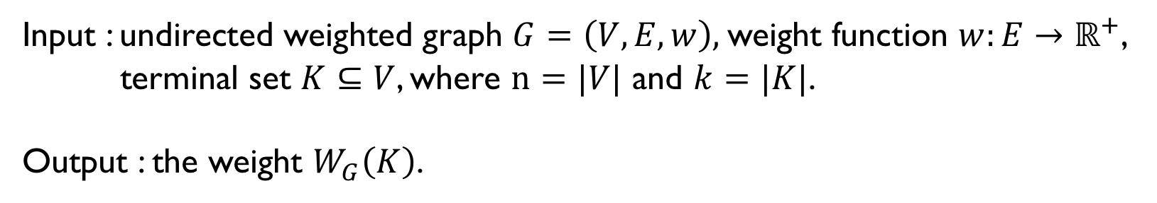
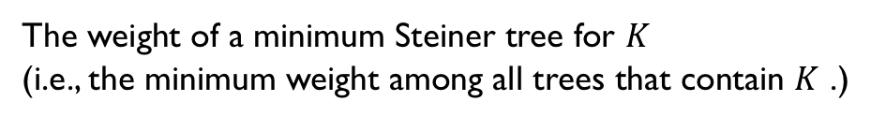

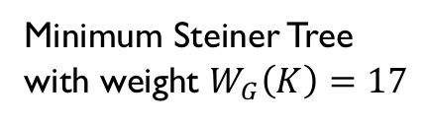
The Minimum Steiner Tree Problem
Input : undirected weighted graph $G=\left(V,E,w\right),$weight function $w:E→ℝ^{+}$,
terminal set $K⊆V$, where $n=|V|$ and $k=|K|$.
Output : the weight $W_{G}\left(K\right)$.
Definition of $W_{G}\left(K\right)$
The weight of a minimum Steiner tree for $K$
(i.e., the minimum weight among all trees that contain $K$ .)
One of the most fundamental NP-hard problems in the graph theory
Many exponential time classical algorithms with respect to $k=|K|$
1
1
3
4
4
3.5
3
4
4
3.5
2
1.11
2
2
1.11
Minimum Steiner Tree
with weight $W_{G}\left(K\right)=17$
2
4
4
2
3
1
0.5
2
3
1
0.5
8
8
$$k=\left|K\right|=4$$
Notes:
I start with the definition of the problem. In the minimum Steiner tree problem, we are given an undirected graph G, with weight function w, and a subset K of vertices which is called terminal set. In this talk we assume that the size of node is n and the size of terminal set is k.
The output is the weight W_g of K. the definition of W_G of K is the minimum weight of trees among all trees that contains terminal set K.
The minimum Steiner tree problem is one of the most fundamental NP-hard problems. And there are many exponential time classical algorithms with respect to k, the size of the terminal set.
In this presentation, we only care about the weight of a minimum Steiner tree. So, for instance, in this below graph with the size of the terminal set is 4, we only need the value seventeen and don’t care about a specific minimum Steiner tree.

Slide 3
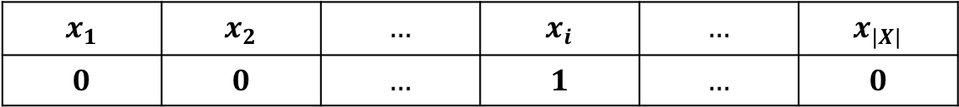
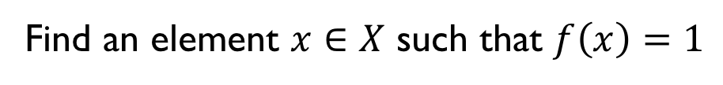
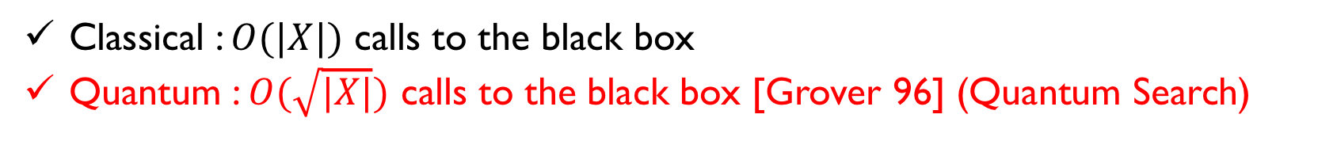


Quantum Search
Consider a function $f:X→\left\{0,1\right\}$ given as a black box.
$$x∈X$$
Black box
$$f\left(x\right)∈\left\{0,1\right\}$$
$$x_{1}$$ | $$x_{2}$$ | $$…$$ | $$x_{i}$$ | $$…$$ | $$x_{|X|}$$
$$0$$ | $$0$$ | $$…$$ | $$1$$ | $$…$$ | $$0$$
Find an element $x∈X$ such that $f\left(x\right)=1$
Classical : $O(|X|)$ calls to the black box
Quantum : $O(\sqrt{|X|})$ calls to the black box [Grover 96] (Quantum Search)
Notes:
To explain our results, I introduce quantum search.
We consider a Boolean function f, given as a black box.
For given an input x, the black box outputs f(x).
We consider a task, “find an element x of the input such that f(x) is one”.
In the classical setting, the number of queries to the black box to solve this task is linear in the input size.
But we can solve this task with square-root of queries to the black box in the quantum setting.

Slide 4
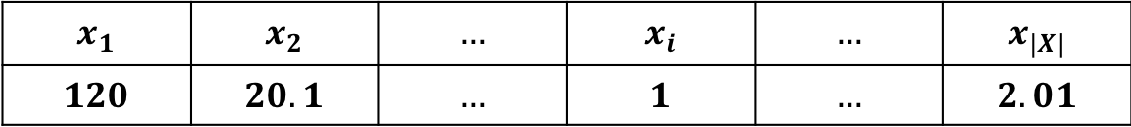

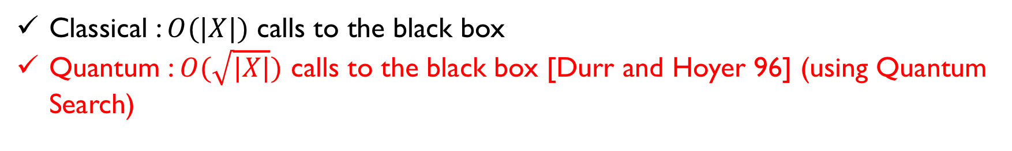
Quantum Search for finding the minimum value
Consider a function $f:X→ℝ$ given as a black box.
$$x∈X$$
Black box
$$f(x)$$
$$x_{1}$$ | $$x_{2}$$ | $$…$$ | $$x_{i}$$ | $$…$$ | $$x_{|X|}$$
$$120$$ | $$20.1$$ | $$…$$ | $$1$$ | $$…$$ | $$2.01$$
Find the minimum value $\min_{x∈X}f\left(x\right)$
Classical : $O(|X|)$ calls to the black box
Quantum : $O(\sqrt{|X|})$ calls to the black box [Durr and Hoyer 96] (using Quantum Search)
Notes:
We also consider the function which outputs values in real numbers.
And we are required to find the minimum value over all possible input.
we also need linear number of queries in the classical setting and square-root number of queries in the quantum setting.

Slide 5
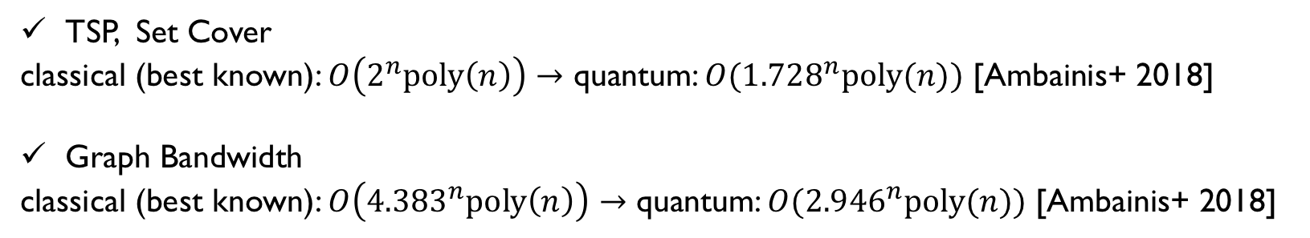
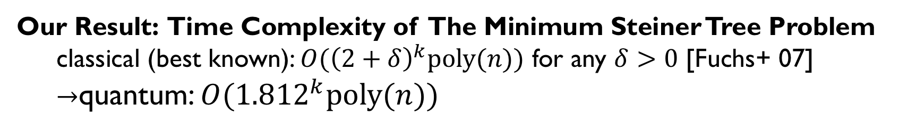
Quantum Search + Dynamic Programming
[Ambainis+ 2018]: Combine classical dynamic programming alg. with quantum search.
Quantum search using the information by classical dynamic programming
TSP, Set Cover
classical (best known): $O\left(2^{n}poly\left(n\right)\right)→$ quantum: $O({1.728}^{n}poly(n))$ [Ambainis+ 2018]
Graph Bandwidth
classical (best known): $O\left({4.383}^{n}poly\left(n\right)\right)→$ quantum: $O({2.946}^{n}poly(n))$ [Ambainis+ 2018]
Our Result: Time Complexity of The Minimum Steiner Tree Problem
classical (best known): $O{(\left(2+δ\right)}^{k}poly(n))$ for any $δ>0$ [Fuchs+ 07]
$→$quantum: $O({1.812}^{k}poly(n))$
Notes:
The recent work by Ambainis revealed that combining quantum search with classical dynamic programming algorithms can speedup the computational complexity for some NP-hard problems.
For instance, TSP and Set Cover can be computed in 2 to the n using classical best known algorithms, and they constructed 1.728 to the n time quantum algorithm.
All the algorithm use the similar framework: quantum search using the information by classical dynamic programming.
Our result is about the minimum Steiner tree problem.
This can be solved in the order of almost 2 to the k poly n using the best known classical algorithm.
We constructed a quantum algorithm with order of 1.812 to the k poly n.
Using the similar framework to ambainis’s work.
And this can be seen as an another application of the idea of this previous work.

Slide 6

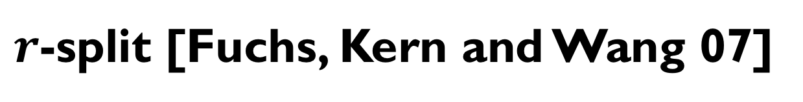


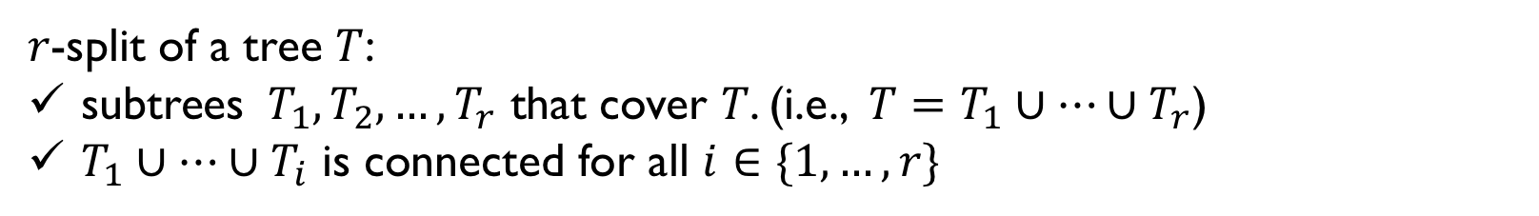

$r$-split [Fuchs, Kern and Wang 07]
$r$-split of a tree $T$:
subtrees $T_{1},T_{2},…,T_{r}$ that cover $T$. (i.e., $T=T_{1}∪⋯∪T_{r}$)
$T_{1}∪⋯∪T_{i}$ is connected for all $i∈\{1,…,r\}$
$$T$$
$$T_{1}$$
$$T_{2}$$
$$T_{3}$$
$3$-split is used to construct $O({2.684}^{k}poly(n))$-time algorithm [Fuchs, Kern and Wang 07]
Notes:
We use a decomposition of a tree, called “r-split”, in our algorithm.
r-split is introduced in the work about classical algorithms for the minimum Steiner tree.
R-split of tree T is subtrees T1, T2, to Tr that cover T
And for any index I, the union of T1 to Ti is connected.
These subtrees doesn’t require to be edge disjoint.
3-split is used in order of 2.684 to k time classical algorithm.

Slide 7
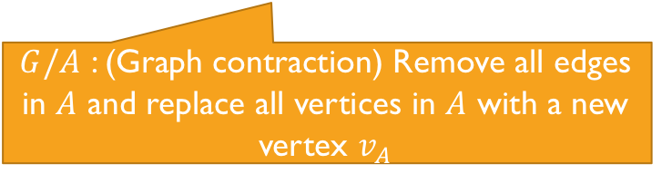

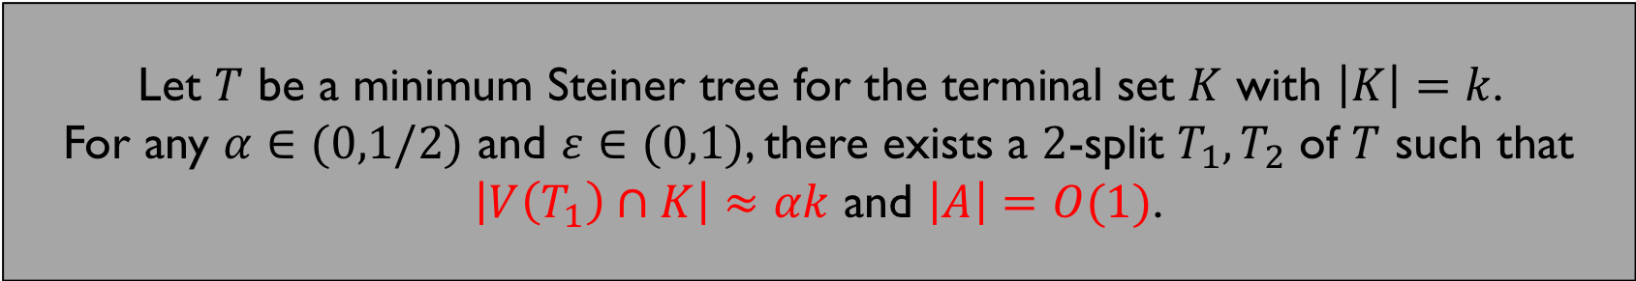
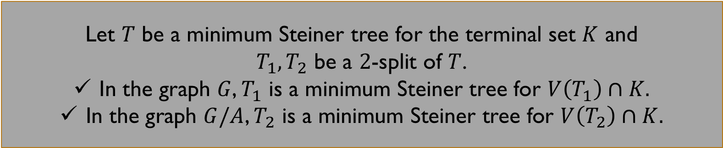


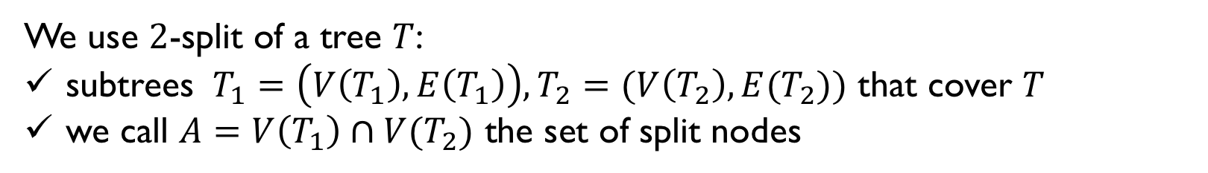
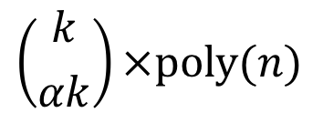




$2$-split
Recursion using 2-split:
We use $2$-split of a tree $T$:
subtrees $T_{1}=\left(V\left(T_{1}\right),E\left(T_{1}\right)\right),T_{2}=(V\left(T_{2}\right),E(T_{2}))$ that cover $T$
we call $A=V\left(T_{1}\right)∩V(T_{2})$ the set of split nodes
$$W_{G}\left(K\right)= min min \{W_{G}\left(K_{1}∪A\right)+W_{G/A}\left(K_{2}∪v_{A}\right)\}$$
$$K_{1}⊆K$$
$$\left|K_{1}\right|≈αk$$
$$A⊆V$$
$$\left|A\right|=O(1)$$
Let $T$ be a minimum Steiner tree for the terminal set $K$ with $\left|K\right|=k$.
For any $α∈(0,1/2)$ and $ε∈(0,1)$, there exists a $2$-split $T_{1},T_{2}$ of $T$ such that
$\left|V\left(T_{1}\right)∩K\right|≈αk$ and $\left|A\right|=O(1)$.
Let $T$ be a minimum Steiner tree for the terminal set $K$ and
$T_{1},T_{2}$ be a $2$-split of $T$.
In the graph $G$, $T_{1}$ is a minimum Steiner tree for $V\left(T_{1}\right)∩K.$
In the graph $G/A$, $T_{2}$ is a minimum Steiner tree for $V\left(T_{2}\right)∩K.$
Computing $W_{G}\left(K\right)$:
$$\left({k \atop αk}\right)×poly(n)$$
Classical :
accesses to the value
$$\sqrt{\left({k \atop αk}\right)}×poly(n)$$
$G/A$ : (Graph contraction) Remove all edges in $A$ and replace all vertices in $A$ with a new vertex $v_{A}$
Quantum :
$$G$$
$$G/A$$
accesses to the value
A
$$v_{A}$$
$\left|V\left(T_{1}\right)∩K\right|≈αk means \left(α−ε\right)k≤\left|V\left(T_{1}\right)∩K\right|≤\left(α+ε\right)k$ for some small constant $ε$.
Notes:
We use 2-split: 2-split is a subtrees T1 and T2 that cover T.
We call the vertices which is in both of the subtrees split nodes.
2-split has a is usefull property when the original tree T is a minimum Steiner tree for the terminal set K such that for any alpha, there exists 2-split T1 and T2 such that the size of subset of terminal set in T1 is almost alpha k, and the size of the split node is a constant.
We consider any 2-split T1, T2 of theminimum Steiner tree for the terminal set K.
In the graph G, T1 is a minimum Steiner tree for the intersection of T1 and K.
In the graph G over A, T2 is a minimum Steiner tree for the intersection of T2 and K. where G over A is a graph contraction.
Graph contraction G over A means replacing all vertices in A, with a new vertex v_A. We can compute Graph contraction in polynomial time.
So, usig these facts, the following recursion on 2-split holds.
Becaeuse we only need the information about the weights of minimum Steiner trees for the subset of terminal set.
We can compute W_G of K searching all possible values in this recursion in classical setting, so we can say that in the classical setting we need linear number of accesses to the values, and we can bound the number of accesses by this, since we search over all possible subsets with sizes are equal to alpha k.
but in quantum setting the number of accesses we need is the square root of the input size

Slide 8
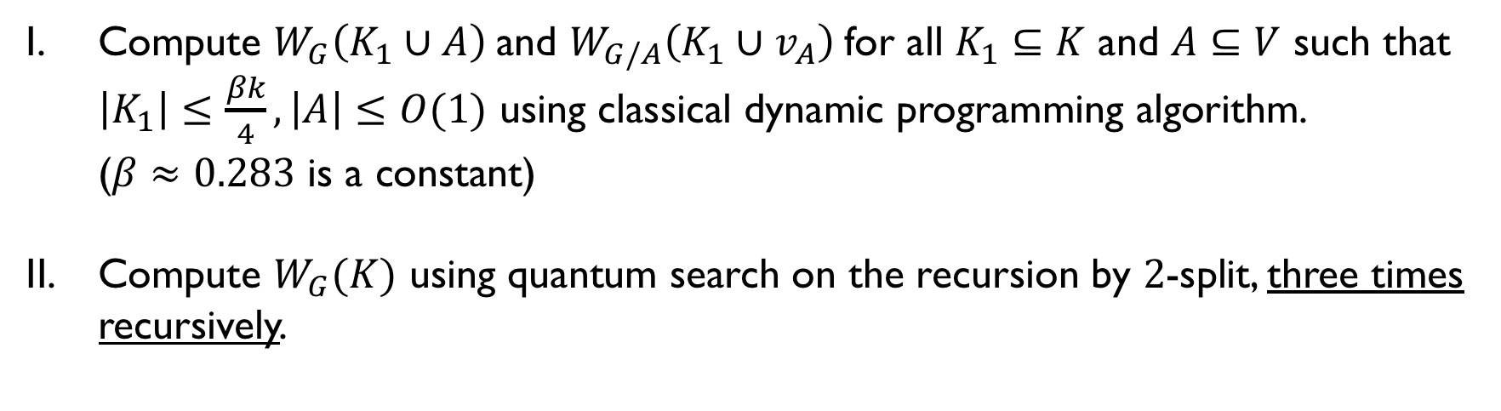
Outline of Our Algorithm
Compute $W_{G}\left(K_{1}∪A\right)$and $W_{G/A}\left(K_{1}∪v_{A}\right)$for all $K_{1}⊆K$ and $A⊆V$ such that $\left|K_{1}\right|≤\frac{βk}{4}, \left|A\right|≤O(1)$ using classical dynamic programming algorithm. ($β≈0.283$ is a constant)
Compute $W_{G}(K)$ using quantum search on the recursion by $2$-split, three times recursively.
Dreyfus-Wagner algorithm
$≈$ we have the database of all the values $W_{G}\left(K_{1}\right)$ for all $K_{1}$ s.t. $\left|K_{1}\right|≤\frac{βk}{4}$
Notes:
I show the outline of our algorithm, which consists of 2 steps.
In step 1, we compute all the weights for terminal set with size are smaller than beta k over 4, and consider split node set with constant size.
To compute the values we can use the classical dynamic programming algorithm called Dreyfus-Wagner algorithm.
We use these values computed in step 1 in step 2.

Slide 9



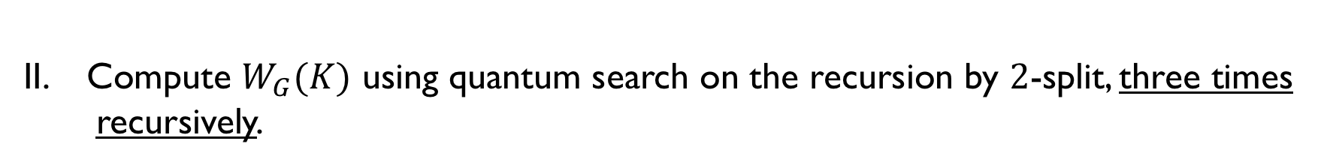
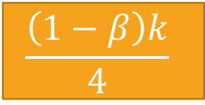


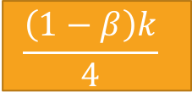











Compute $W_{G}(K)$ using quantum search on the recursion by $2$-split, three times
recursively.
Minimum Steiner Tree for $K$
$2$-split
Subtree
(terminal size $k/2$)
Subtree
(terminal size $k/2$)
$2$-split
$2$-split
$$k/4$$
$$k/4$$
$$k/4$$
$$k/4$$
$$βk/4$$
$$\frac{\left(1−β\right)k}{4}$$
$$βk/4$$
$$\frac{\left(1−β\right)k}{4}$$
$$βk/4$$
$$\frac{\left(1−β\right)k}{4}$$
$$βk/4$$
$$\frac{\left(1−β\right)k}{4}$$
Computed in step 1.
Notes:
In step 2, we compute W_G of K using quantum search three times recursively.
The value W_G of K can be computed using quantum search, which needs all the values with terminal size are equal to k over 2 and the size of the set of the split nodes is a constant.
To access these values, we use the second quantum search on the values and this time we need all the values with terminal size are equal to k over 4.
Again, to access these values, we use the third quantum search, which runs over the values with terminal size are equal to beta k over 4 and one minus beta k over 4.
And this time these values are already computed in step 1.
So, we can compute W_G of K using quantum search three times recursively.

Slide 10
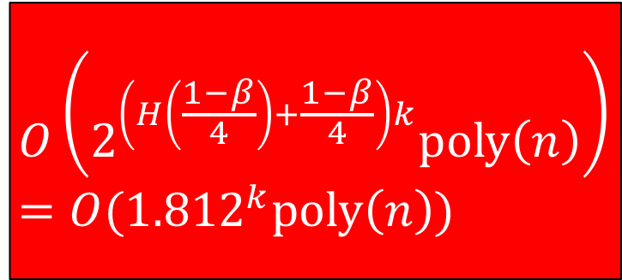
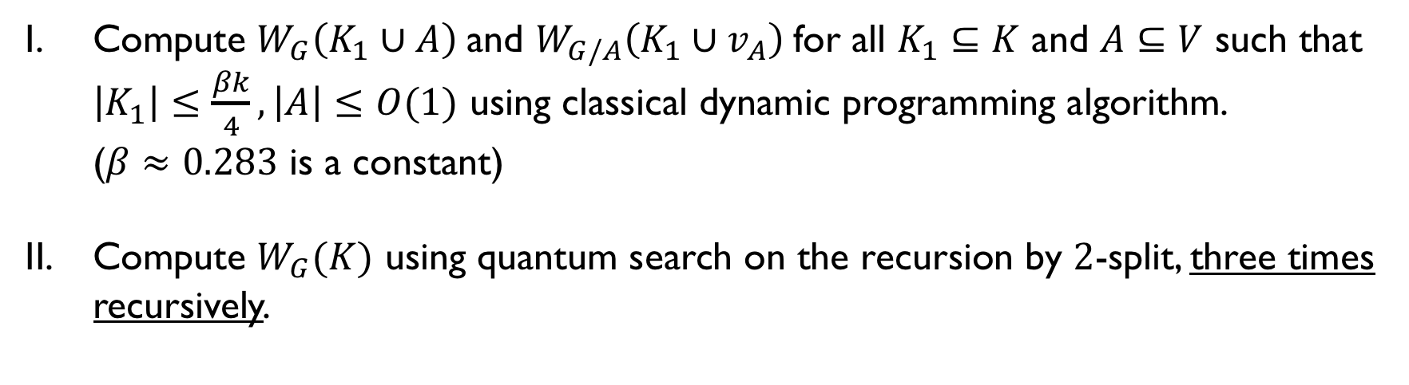
Outline of Our Algorithm
Compute $W_{G}\left(K_{1}∪A\right)$and $W_{G/A}\left(K_{1}∪v_{A}\right)$for all $K_{1}⊆K$ and $A⊆V$ such that $\left|K_{1}\right|≤\frac{βk}{4}, \left|A\right|≤O(1)$ using classical dynamic programming algorithm. ($β≈0.283$ is a constant)
Compute $W_{G}(K)$ using quantum search on the recursion by $2$-split, three times recursively.
$$O\left(2^{\left(H\left(\frac{1−β}{4}\right)+\frac{1−β}{4}\right)k}poly\left(n\right)\right)=O({1.812}^{k}poly\left(n\right))$$
Notes:
We analyse the running time of the algorithm.
In step 1, we run the classical dynamic programming algorithm, so the time complexity of this part can be bounded order of 1.812 to the k poly n.

Slide 11
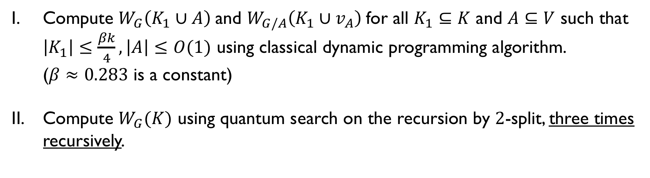
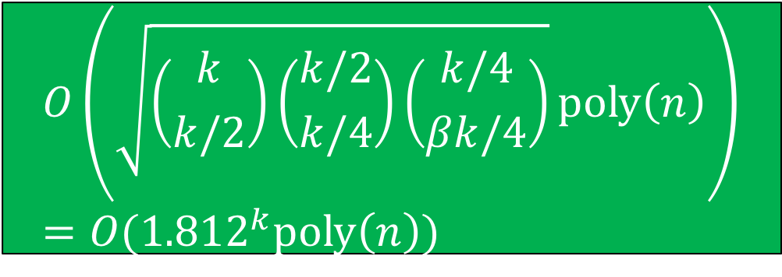
Outline of Our Algorithm
Compute $W_{G}\left(K_{1}∪A\right)$and $W_{G/A}\left(K_{1}∪v_{A}\right)$for all $K_{1}⊆K$ and $A⊆V$ such that $\left|K_{1}\right|≤\frac{βk}{4}, \left|A\right|≤O(1)$ using classical dynamic programming algorithm. ($β≈0.283$ is a constant)
Compute $W_{G}(K)$ using quantum search on the recursion by $2$-split, three times recursively.
$$O\left(2^{\left(H\left(\frac{1−β}{4}\right)+\frac{1−β}{4}\right)k}poly\left(n\right)\right)=O({1.812}^{k}poly\left(n\right))$$
$$O\left(\sqrt{\left({k \atop k/2}\right)\left({k/2 \atop k/4}\right)\left({k/4 \atop βk/4}\right)}poly\left(n\right)\right)=O({1.812}^{k}poly\left(n\right))$$
+
Notes:
In step 2, we use quantum search three times recursively., so the time complexity of this part can be bounded order of 1.812 to the k poly n we properly choosed the value of the parameter beta.

Slide 12

Outline of Our Algorithm
Compute $W_{G}\left(K_{1}∪A\right)$and $W_{G/A}\left(K_{1}∪v_{A}\right)$for all $K_{1}⊆K$ and $A⊆V$ such that $\left|K_{1}\right|≤\frac{βk}{4}, \left|A\right|≤O(1)$ using classical dynamic programming algorithm. ($β≈0.283$ is a constant)
Compute $W_{G}(K)$ using quantum search on the recursion by $2$-split, three times recursively.
If we use $r$-split where $r≠2$, the complexity becomes worse.
If we use more recursive quantum search, the complexity becomes worse.
Notes:
If we consider r-split where r is not 2, the complexity becomes worse
And
If we consider to use more recursive quantum search, say four times recursively, the complexity becomes worse.
Also, if we use two times or even one time quantum search, the classical part, step 1 of this algorithm becomes worse complexity.

Slide 13
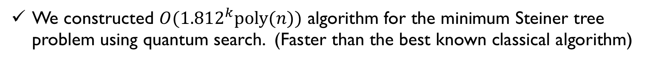
Conclusion
We constructed $O({1.812}^{k}poly(n))$ algorithm for the minimum Steiner tree problem using quantum search. (Faster than the best known classical algorithm)
Open problem
Further speeding up of the minimum Steiner tree
Speeding up other NP-hard problems using quantum search
Notes:
What I explained in this presentation is an algorithm with computational complexity irder of 1.812 to the k poly n using quantum search.
I conclude with some open problems,
Furhter speeding up of the minimum Steiner tree problem
And also
Speeding up other NP-hard problems using quantum search
Thank you.

